Slide 1


Health Education Kent Surrey Sussex
Care Certificate Meeting 16th September 2019
Mike Bailey, Career Progression Programme Manager
Jayne Thwaites, Pre-employment Co-Ordinator Sussex

Slide 2
Meeting Focus
During the meeting we will:
  Working through the standard together
  Judge evidence together
  Comparing and agreeing on assessment decisions
The aims of this are to:
  Ensure that high standards of learning delivery are maintained
  Ensure that the national standards are adhered to by all assessors
  Evaluating the planning and preparation of the assessment process
  Identify problems or areas where assessors require advice or development
  Comparing assessment decisions
  Identifying areas for improvement
  Agreeing standardisation for completion of the standard across HSC sectors

Slide 3
National/Regional Update
Stop, Look, Care Project Manager in post and will look to link them into this group
Online packages through E-learning for Health - number of active users per quarter is between 2.5-4K from 2018 onwards; approximately half of new users per quarter are active
Care Certificate e-learning programme evaluation is ongoing; currently 279 users have participated and feedback is really encouraging, particularly participants’ response to whether they would recommend the e-learning programme
The five scenarios being add on e-lfh are:
  Maternity Support Worker in a maternity unit (started Aug 19)
  Therapy Support Worker in a home care setting (started Aug 19)
  Ambulance Support Worker in emergency care setting
  Support worker working in paediatric setting
  Mental Health Support Worker in homeless setting
We are looking locally at numeracy and literacy support, scoping what provision is available
Over the next two years Skills for Care will be developing additional support to help employers contextualise the Care Certificate for some specific areas of practice. This additional support will be called ‘clusters’ and will provide additional contextualised information, knowledge and learning for these areas.

Slide 4
Communication Standard
6.1 Understand the importance of effective communication at work
  6.1a Describe the different ways that people communicate
  6.1b Describe how communication affects relationships at work
  6.1c Describe why it is important to observe and be receptive to an individual’s reactions when communicating with them
6.2 Understand how to meet the communication and language needs, wishes and preferences of individuals
  6.2a Describe how to establish an individual’s communication and language needs, wishes and preferences
  6.2b List a range of communication methods and styles that could help meet an individual’s communication needs, wishes and preferences
6.3 Understand how to promote effective communication
  6.3a List barriers to effective communication
  6.3b Describe ways to reduce barriers to effective communication
  6.3c Describe how to check whether they (the HCSW/ASCW) have been understood
  6.3d Describe where to find information and support or services, to help them communicate more effectively

Slide 5
Communication Standard
6.4 Understand the principles and practices relating to confidentiality
  6.4a Describe what confidentiality means in relation to your role
  6.4b List any legislation and agreed ways of working to maintain confidentiality in day-to-day communication
  6.4c Describe situations where information, normally considered to be confidential, might need to be passed on
  6.4d Describe who they should ask for advice and support about confidentiality
6.5 Use appropriate verbal and non-verbal communication
  6.5a Demonstrate the use appropriate verbal and non-verbal communication:
6.6 Support the use of appropriate communication aids/ technologies
  6.6a Ensure that any communication aids/ technologies are: ▪ Clean ▪ Work properly ▪ In good repair
  6.6b Report any concerns about the communication aid/ technology to the appropriate person.

Slide 6
Standardisation
A method of comparison that enables assessors to review the consistency and accuracy of their assessment decisions with those of other assessors
Will enable portability of the Care Certificate across health & social care organsiations

Slide 7
Standardisation provides a system for checking the quality of the assessment process to ensure it is:
Sufficient meets all the requirements of the standard
Current sufficiently recent for assessors to be confident that the learner has the same level of skills or knowledge as when originally assessed
Authentic produced by the learner
Reliable genuinely representative of the learners knowledge & skills
Valid relevant to the standards for which competence is claimed

Slide 8



Jill Durrant,
Widening Participation Lead

Slide 9
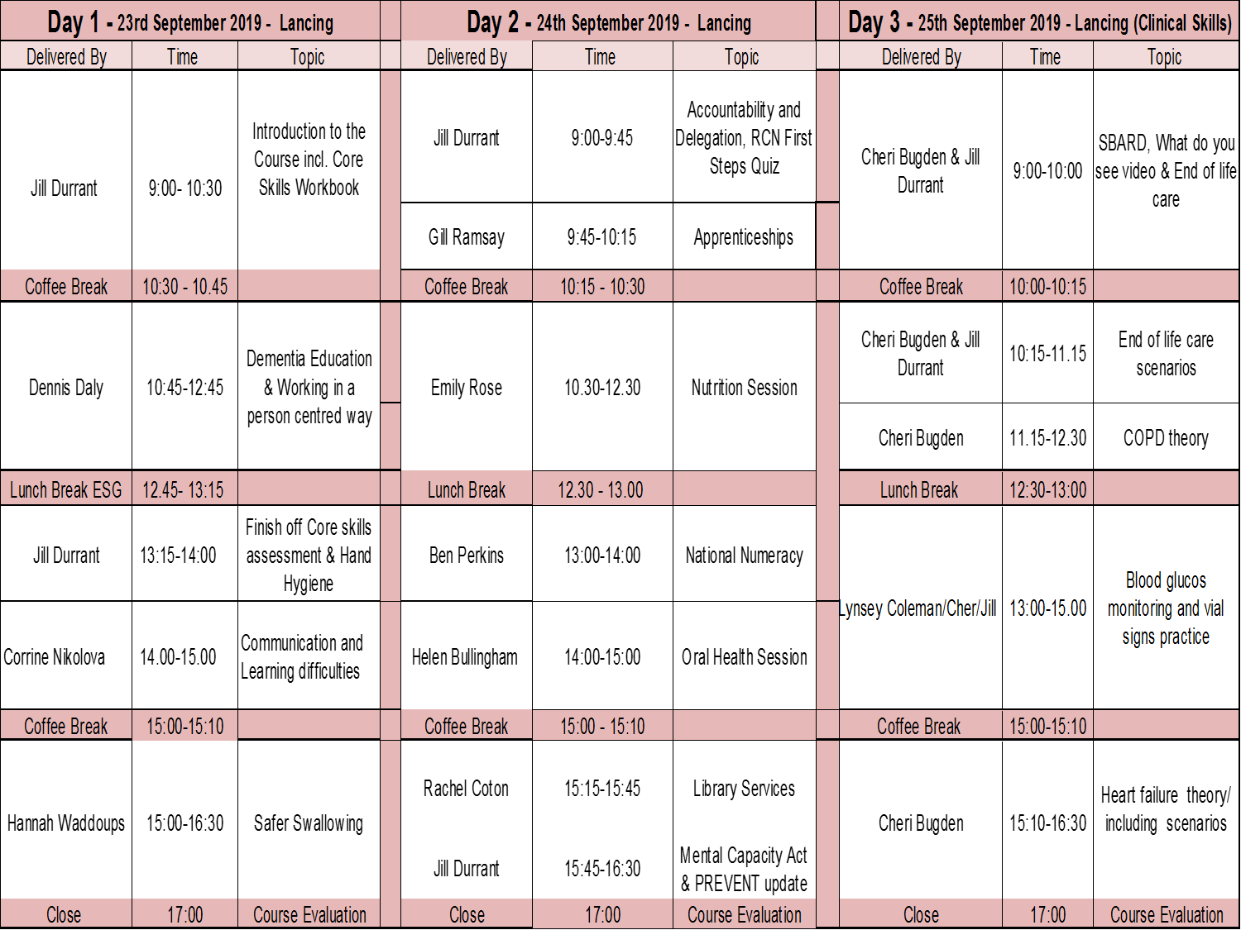

Slide 10
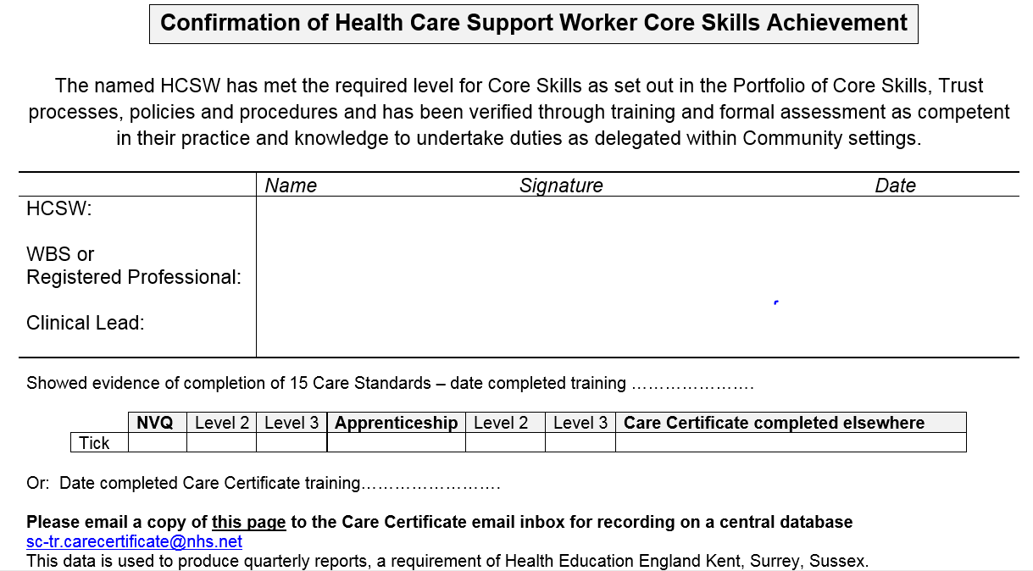

Slide 11
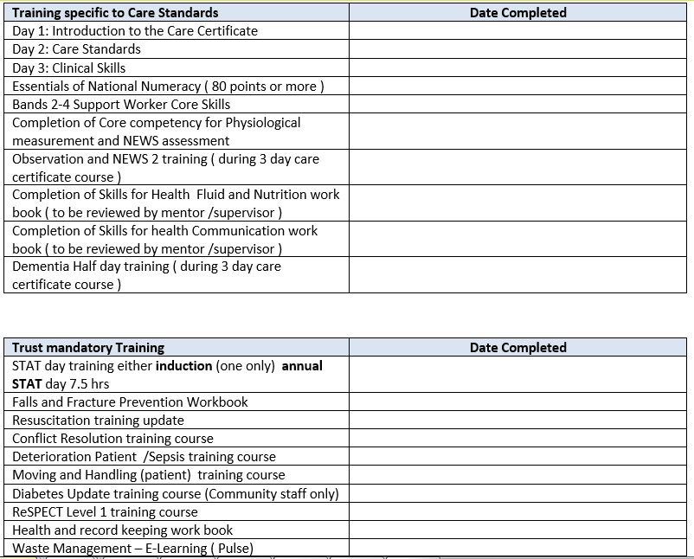

Slide 12
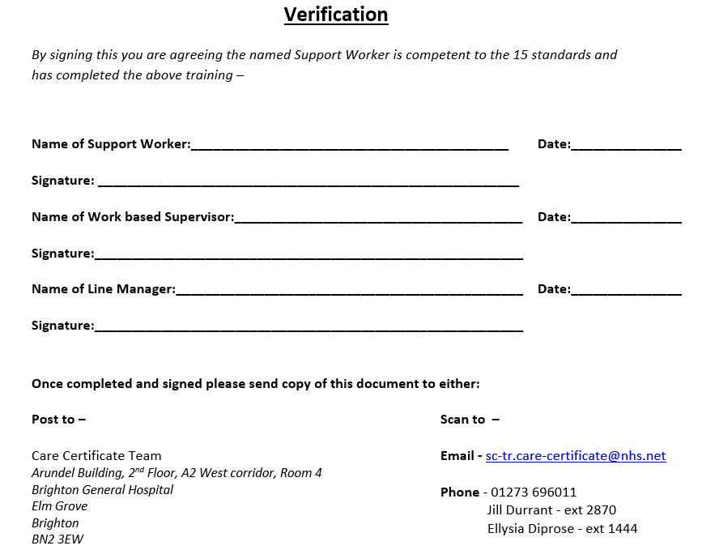

Slide 13
Organisational Examples
Central Surrey Health
  completed example
Virgin Care
  complete modules and write a reflective (Gibbs or Rolfe model) piece on each standard to represent their learning. The Communication module they complete is from the National Skills Academy.
Royal Surrey County Hospital
  Communication teaching plan, competency standard assessed against
Sussex Community NHS Foundation Trust
    Guide for work placed supervisors, nursing development information, new starter documentation, care certificate verification, hospital communication book
NHS Frimley Health Foundation Trust
  Self-assessment tool, induction programme, observation portfolio
First Community Healthcare
East Sussex County Council
  Want to link in to discussions in terms of personal assistants and personal health budgets, piloting a course in partnership with the High Weald Lewes Havens Clinical Commissioning Group based on the Stop, Look, Care Booklet
Notes:
SCFT
The communication session on the care certificate is focussed on patients/clients with learning difficulties and is delivered by a LD nurse.
We also give out the Hospital Communication book as part of the session as well ( please see attached )
We have the care certificate course now on ESR so when staff send in their verification pages we cross check on ESR that all their mandatory courses and training are complete before we issue the certificate
Please see verification pages for staff to complete to confirm that they have completed all the required assessments and competencies
As you know, we ask staff to complete the Essential of Numeracy challenge and gain 80 point or more which equates to Functional maths Level 2. They will have six months to complete this after the 3 day programme
We have just up dated the core skills linked to the 15 standards see 3-care certificate
In regard to the Communication standard we ask staff to complete the SfH work book and get this checked over by their WBS
I have also attached the 3 day programme for later this month to give you an overview of what we teach during the 3 day care certificate course
FCH - I use the national workbooks (which I have adapted slightly) and I personally assess and sign them off for the theoretical knowledge element. (It is relatively easy to do this in a small organisation with small numbers.) If they find written work challenging, I ask them questions and note down their answers in the workbooks. I am interested to hear them telling me what they know, not seeing how well they can write a piece of work.
I then require someone from their clinical area to assess them for the practical application of the content. They do not need to be an NMC Mentor for this but I give them a short session on what the care certificate is and how to do the assessment (I call it assessor training but that may be too grand a word to be honest).
I do not require assessments to be done on the topics that are covered in stat and mand training, but I do give the candidate these workbooks for reference and I tell their assessors to feel free to use them if applicable – ie. if the assessor feels there is an element of eg infection control /IG that the candidate needs to work / improve on.

Slide 14
Organisational Examples

Slide 15
Questions for discussion
How can we make the Care Certificate relevant to HCSW’s in General Practice?
If an HCA has achieved an NVQ Level 2 or 3, are they exempt from completing the Care Certificate in your organisation?
Does anyone use an e-portfolio, with a facility for supervisors to add comments & review progress?
Is anyone aware of an information guide about the Care Certificate that is relevant specifically to staff working in GP Practices?

